Slide 1
Module 1: Lesson 1 – Soil Sampling Methods
Notes:
We will be breaking soil sampling into two lessons, the first one will focus on the basic process of collecting a soil sample that is representative of a field or a portion of a field and the second one will be focused on using fertilizer recommendation guidelines to develop a fertilizer application plan.

Slide 2
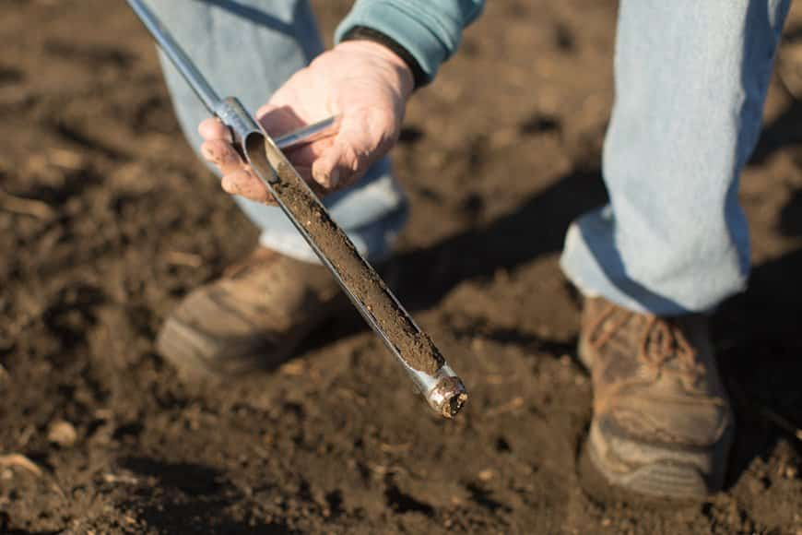
What is Soil Sampling?
Soil Sampling is the process of taking small samples from different areas of a field
We then test those samples for certain physical and chemical properties.
Notes:
Ask students:
Q: why would farmers want to soil sample their fields?
A: Possible answers
Nutrient Management – To determine nutrient levels (N, P, K, etc.) and apply fertilizers efficiently.
pH Balance – To check soil acidity or alkalinity and apply lime or sulfur as needed.
Crop Yield Optimization – To ensure crops have the right nutrients to maximize production.
Fertilizer Cost Savings – To avoid over-applying fertilizers and wasting money on unnecessary inputs.
Environmental Protection – To prevent nutrient runoff that can pollute waterways.
Precision Agriculture – To use variable-rate technology (VRT) for site-specific fertilizer applications.
Soil Health Monitoring – To track organic matter, microbial activity, and soil structure over time.
Irrigation Planning – To assess water-holding capacity and drainage issues.
Crop Rotation Planning – To determine nutrient depletion from previous crops and adjust rotations accordingly.
Land Value Assessment – To evaluate soil fertility for land purchases or rental agreements.
Research & Field Trials – To compare different management practices in test plots.
Improved Seed Selection – To match soil conditions with the best crop varieties for the field.

Slide 3
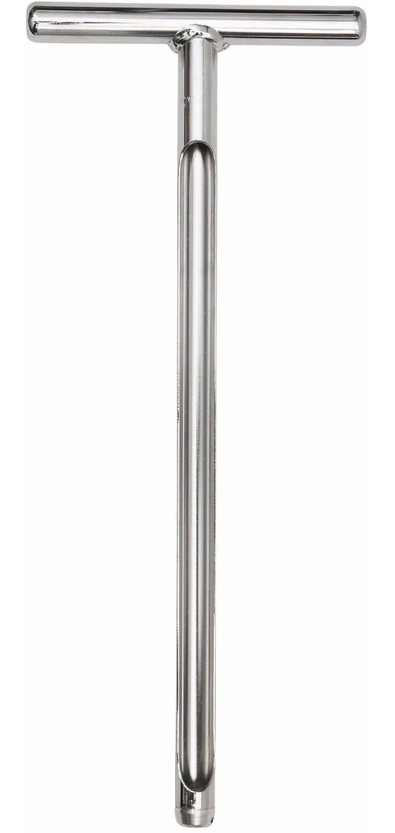
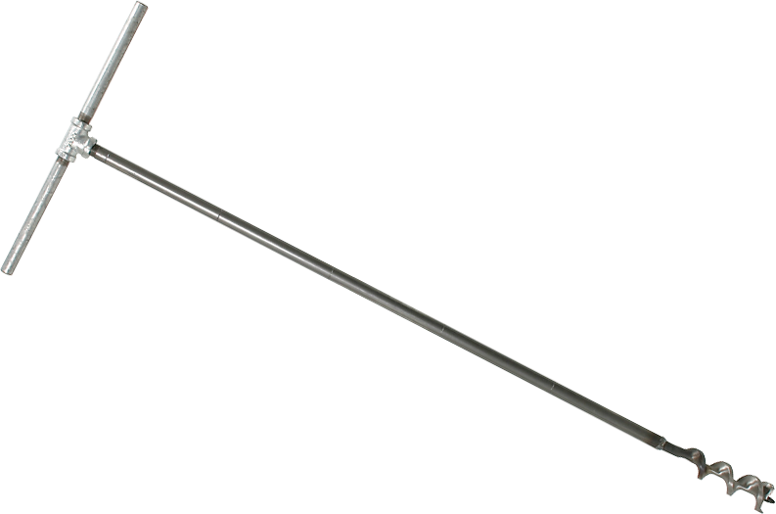
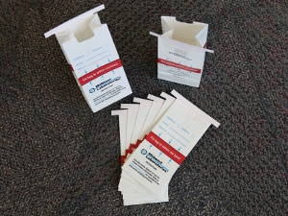
Soil Sampling Equipment
Two things you must have for soil sampling are
Sample bags
Some kind of soil probe
Notes:
The type of soil sampling equipment that we use is generally specific to your region and your types of soils. There are two kinds of soil sampling devices that are the most common. The first one is a soil probe, which is a steel tube with a large open slot in it. As you pull the probe out of the ground, you simply use the open slot in the probe to remove the soil samples. This is the primary types of soil sample that is used here in the US where we have generally softer soils. When we get into soils that are harder, then an auger bit is also used. Is some parts of the US, you will see this as a primary practice. These can be put in by hand or they can be battery or gas powered. There are also non-hand operated options where automatic soil sample probes are mounted onto some kind of ATV or other vehicle.
As for how far the probe goes into the ground, in a tilled field, the general recommendations are a 6 in depth soil sample for P, K, Zinc, as well as organic matter and pH. However, in a no till field, it is recommended that the soil sample only include the top 2-3 inches of soil. It is also important that residue is not included.
To transfer the samples to the lab for analysis you are generally going to use a soil sampling bag like the ones shown here. These are generally standardized across the US in terms of size, we are usually dealing with a fairly small sample. Whats important in this process is the sample bag that we are sending to the lab to analyze MUST be labeled appropriately with the sample ID number that matches up with the GPS locations of where that sample was collected from. If you just randomly label the bags and don’t have that correlated back to the map that was used to generate the soil sampling points then you have no way to correlate those back together and to make a soil sampling map. It is critical to the process that the sample bags are labeled properly.

Slide 4
Random Sampling
Samples represent no more than 10-15 acres
Collected in a zig-zag pattern across the field
20-ish samples are mixed together to produce one sample
Advantages
Low cost
Fewer samples to process
Disadvantages
Results are an average, not a measure of variability
Not suited for variable rate application
Notes:
Were going to walk through three different methods that are used to take soil samples. The first method is called random. This random method is where we simply just zig zag a pattern across a field and take individual soil cores and we mix them together to create one sample that represents 10-15 acres of the field. This is still one of the most widely used methods for soil sampling because it is low cost. The fact that it is a random sample without gps specific information means that it is not well suited for variable rate application and generally it really does not give us a measure of variability of soil fertility in a field. It will give us an average for a field or large chunk of a field.

Slide 5
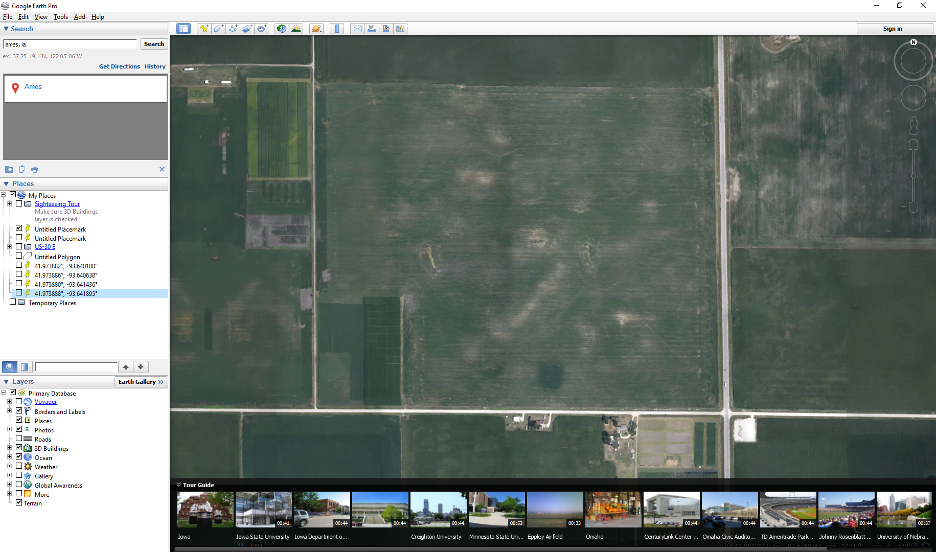
Sample 2
Sample 1
Sample 3
Notes:
This a graphic example of how a random sampling method might look in a field. Each of the yellow dots represents a spot where a single soil sample was taken. All of the individual samples within one of the red ovals will then be mixed together to make a single sample that will be sent to the lab. This entire field will only have three samples when we are done. This is an inexpensive way to approach soil sampling but it does not give us a lot of information on the variability across a field.

Slide 6
Zone Sampling
Samples represent no more than 10-15 acres
20-ish samples are mixed together to produce one sample
Advantages
Provides a better assessment of variability than random sampling
Cost effective
Disadvantages
Typically requires some additional information on the field (yield maps, soil type maps, etc.)
Notes:
The second method of soil sampling is called zone. The zone method is going to take soil cores that represent smaller areas across the field than in random sampling. The main difference between zone and random sampling is that with zone sampling, the area that we are sampling is based on some prior information rather that being random. That could be based on prior soil sample analysis or it could be based on a yield map (soil sample high yielding areas of the field separately from low yielding parts of the field). Another example could be using a terrain map or a soil types map. The main advantage of this method is that it does provide an assessment of variability that is better than random. This method would allow is to create a variable rate map. The primary disadvantage is that this method requires other data to be available in order to define where the zones are. Depending on what part of the world we are in, this can be easier than others. There are some parts of the country where ground is really flat so it would be difficult to use slope to drive soil sampling.

Slide 7
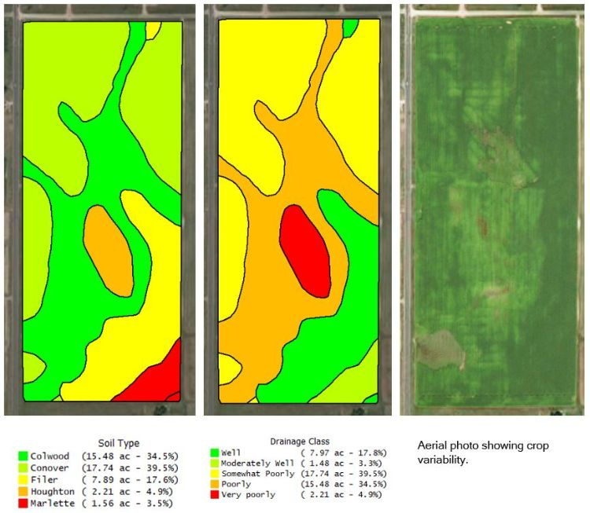
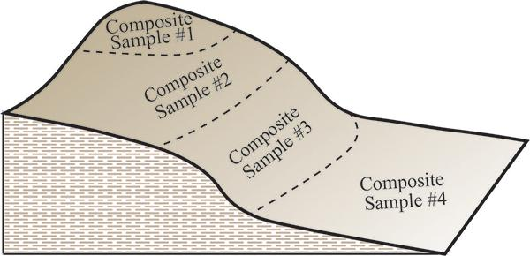
Notes:
This is an example of what zone sampling might look like. The Image of the left shows zone definition based on field elevation and the one on the right is based on soil type. The list of what can be used for soil sampling base maps is almost infinite. It really comes down to what are the local determinants of yield and what data or information is available to you.

Slide 8
Grid Sampling
Field is divided into equal areas
Generally 330ft x 330ft (2.5 acres)
10 samples from each grid cell are mixed together to make one composite sample
Advantages
Provides an excellent assessment of variability
Can support variable rate fertilizer application
Disadvantages
Expensive!
Notes:
Method 3 is what we call grid sampling.
Grid sampling became really popular in the early days of precision ag back in the 1990’s and continues to be popular with producers today. When we do a grid sampling method, we will divide the field into equal sized gridded areas.
There are differences in the grid sizes that are used depending on your region globally but here in the US, we generally use a 2.5 acre grid. There is science out there that suggests that this is not tight enough in terms of a grid spacing but ultimately this comes down to a cost trade off. The smaller we make the grids the more expensive it will be to soil sample the field.
Generally, when you are in a single grid area, it is recommended to take 10 physical samples from around the center of the grid and mix them together to make a single sample. This technique provides a good assessment of variability across a field and it definitely supports a variable rate application. One of the business drivers of this is with a grid sampling method, you do not have to have any prior information or data on a field to complete grid sampling. As long as there is a field boundary, you can auto general grid points to fit that boundary. The disadvantages of this solution are that it is expensive. It is expensive both in the terms of the cost of sampling and the time that is required and in the cost to analyze the physical samples that are generated.

Slide 9
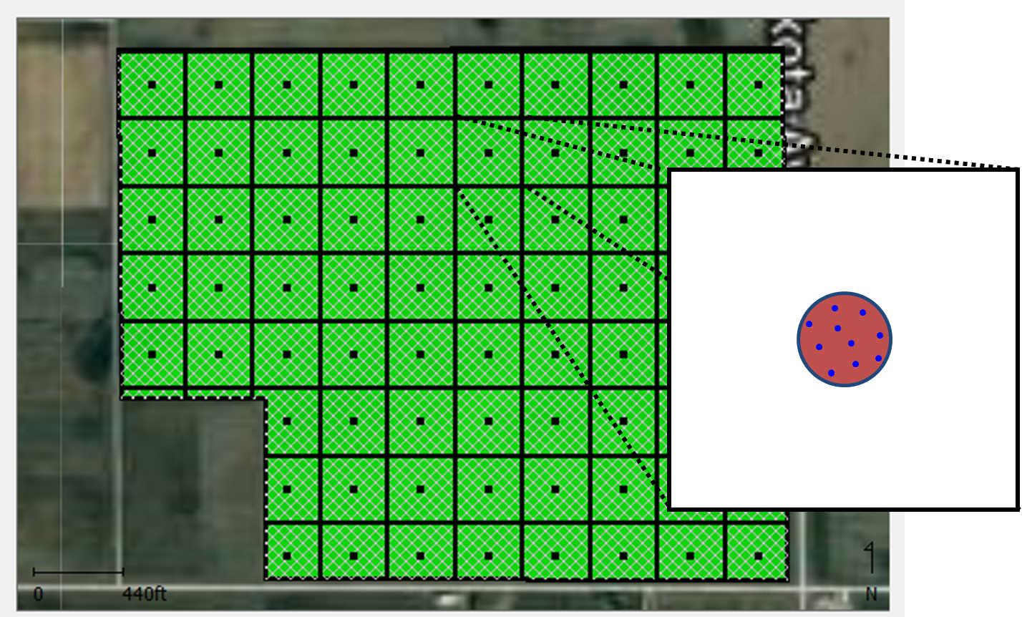
Grid Sampling
Notes:
This is what a grid sampling map might look like. The grid itself is auto generated by some kind of software package based on the grid size that we choose. In this case, we have a 2.5 acre grid show. Each of these individual black squares are 2.5 acres. We can select if we want the point to be in the center of the grid or if we want to offset it.
If we zoom in to one of the grids, we can see how we would actually physically sample within each grid area. What we do not want to do is just go to one point and put a probe in the ground one time and take one sample core. We want to take multiple samples so we can help to reduce our potential bias on a singe individual soil core. The generally best practice for this is when you get to the center point in a grid (probably using some sort of GPS device) your are going to walk 10-15 feet away from the center and then just start walking in a circle around the center taking individual samples. All of the cores that you extract from a grid area will be mixed together to make a single sample. each sample that is sent in to the lab represents only 2.5 acres of the field.

Slide 10
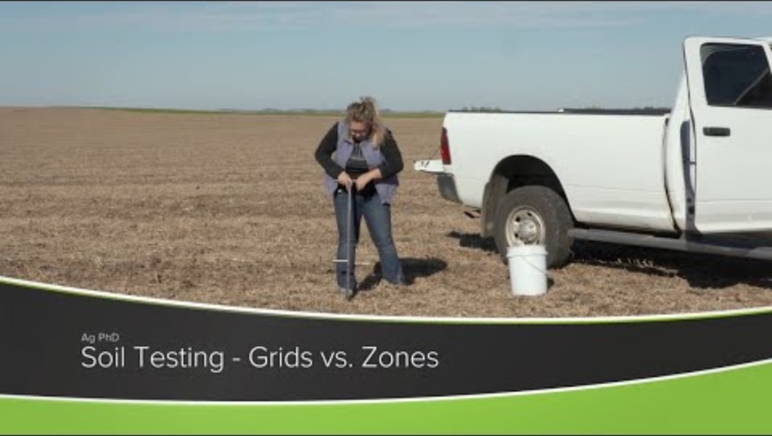
Grid vs. Zone Soil Sampling

Slide 11
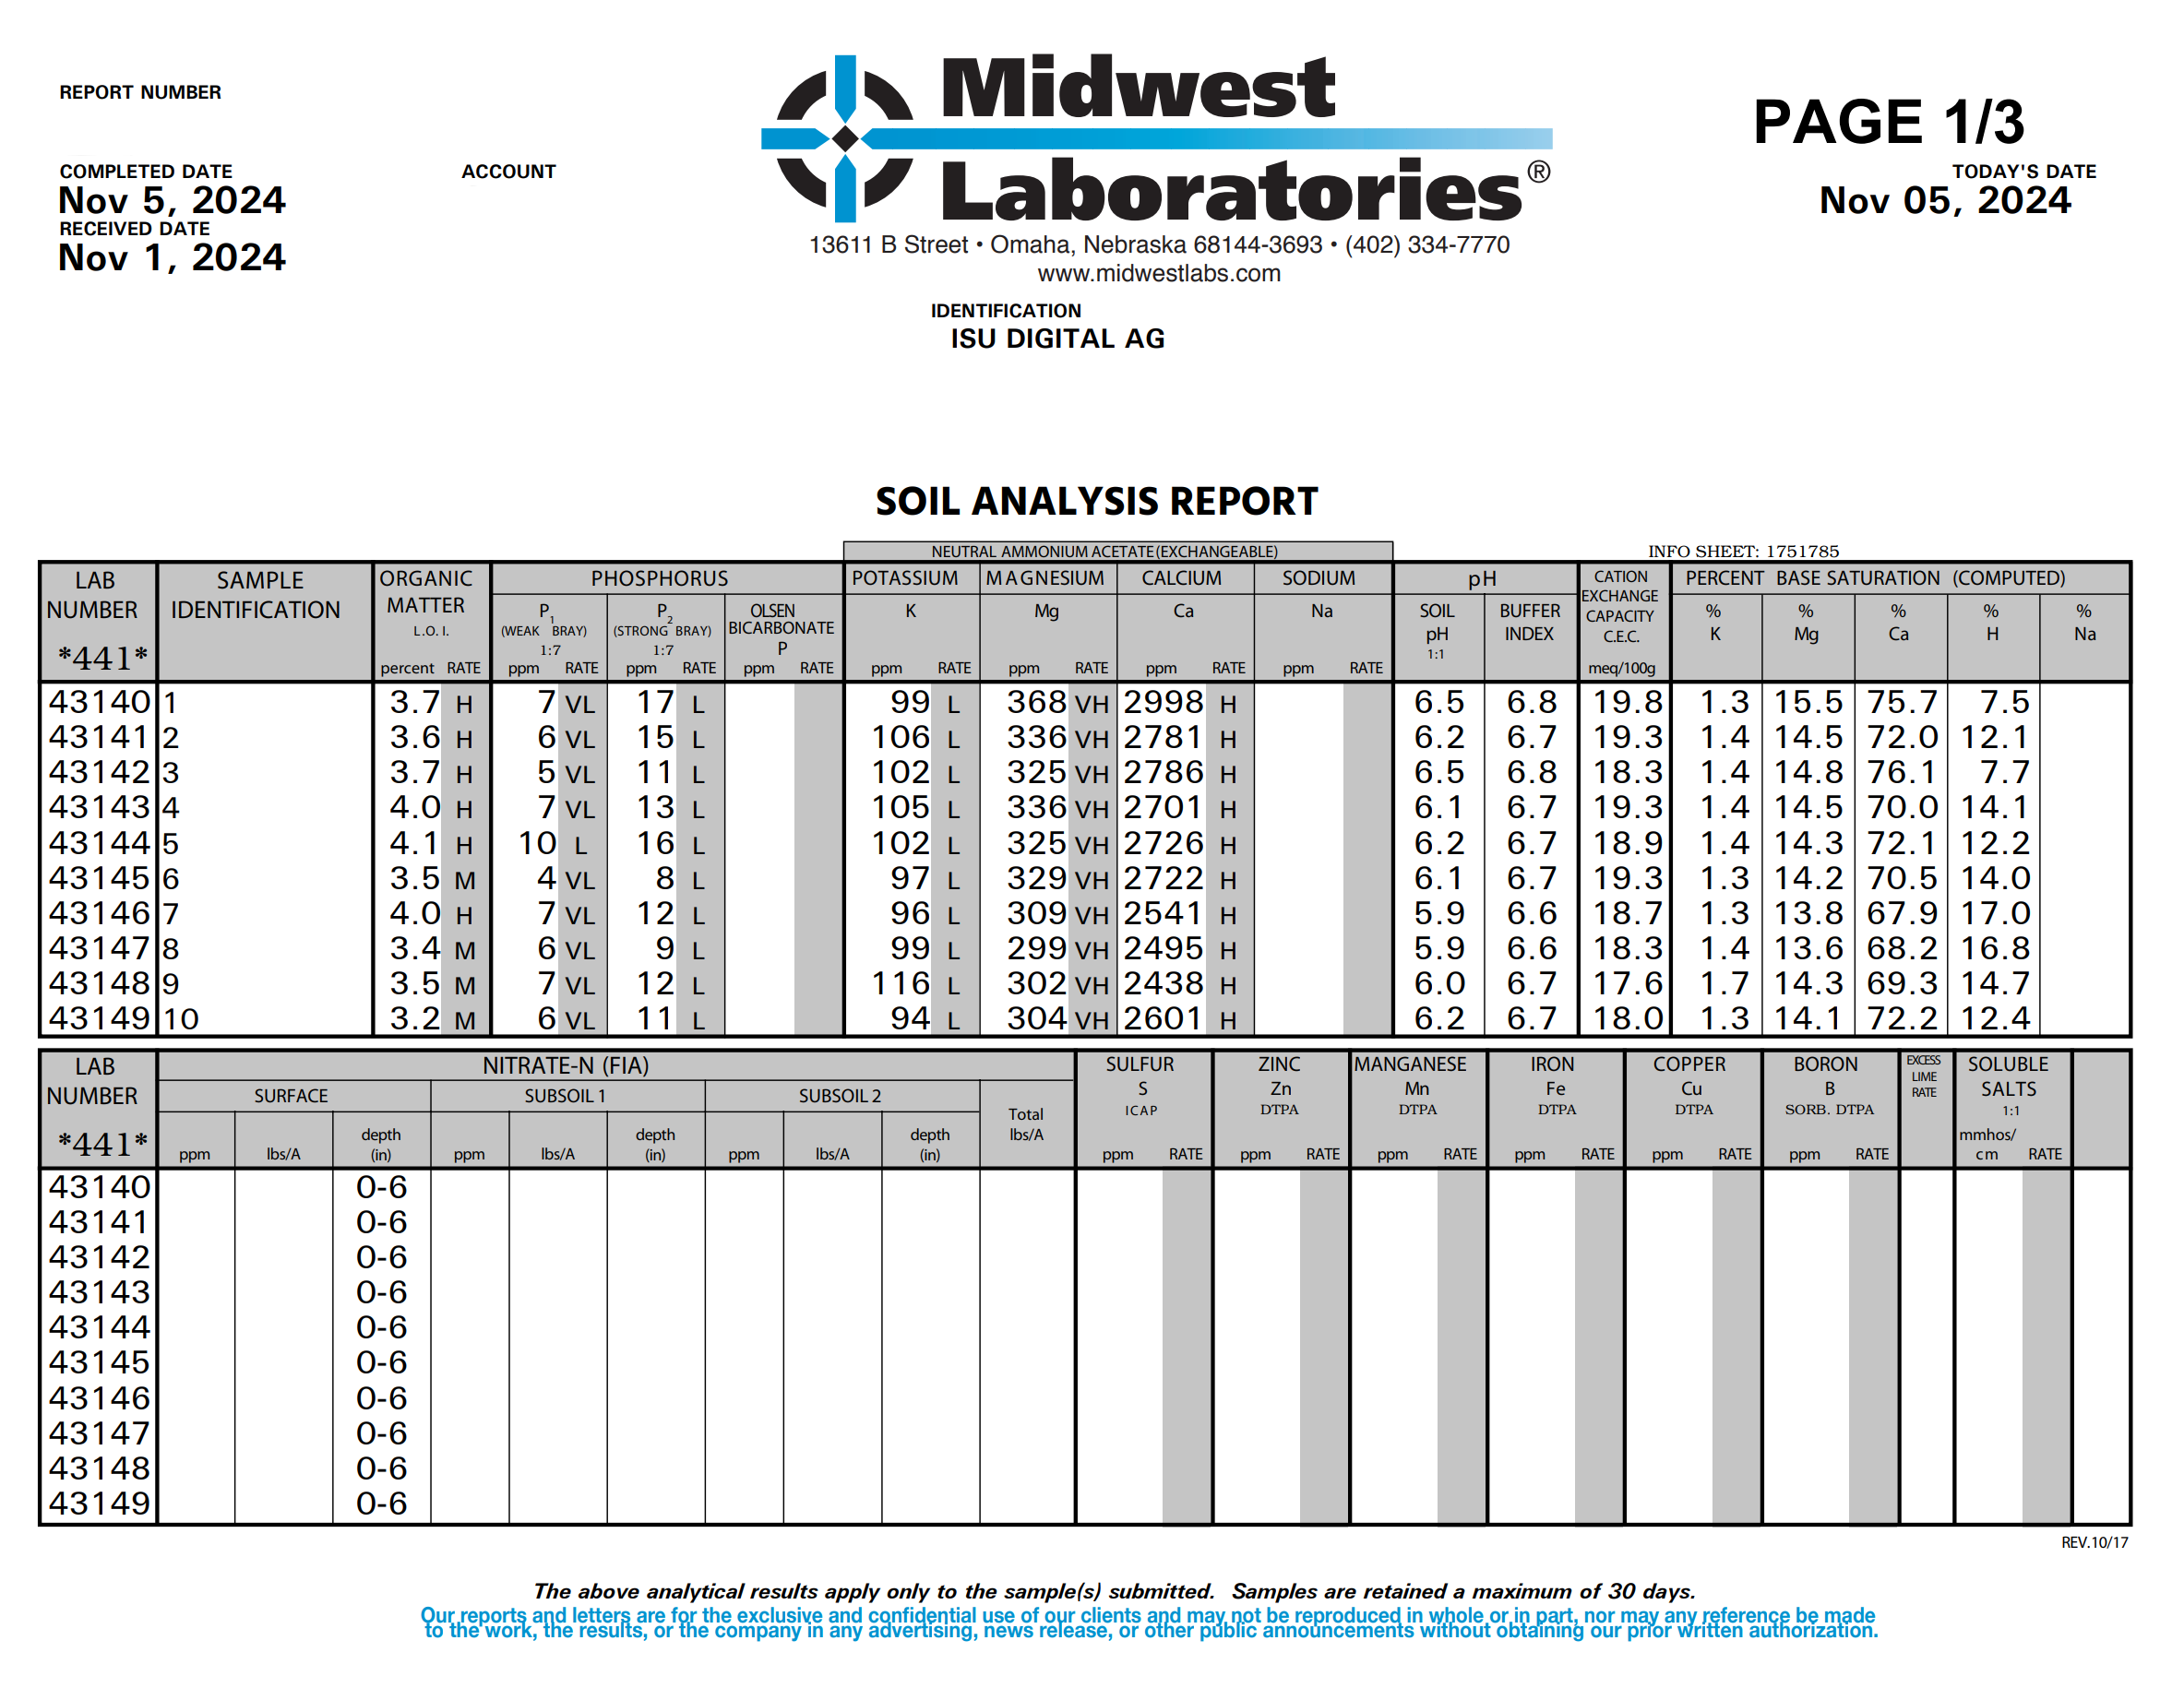
Soil Sample Results
Notes:
Shown on this slide is a typical soil analysis report. This is what you would get back from the lab (Midwest Laboratories in this case). While the exact formatting and terminology can vary slightly by lab, most reports will be very similar.
Lab Number is a unique code or ID that the laboratory assigns internally to track the sample once they receive it. This number really does not mean anything to us but if we have a question or need a sample to be re-run, this is the number that we would reference.
Sample Identification is the label or name that was written on the soil sample bag before sending it to the lab. Sample Identification helps us keep track of where in the field the sample came from, whether it’s a specific field, a grid location, or a zone.
The type of soil test results that we get back from a lab are going to be depended on the package that we purchase. For additional analysis, you simply pay more. pH, organic matter, cation exchange capacity, phosphorus and potassium are the four results that we focus on mostly for ag applications. There are certainly other soil sample results that would be valuable for farmers depending on the situation.
In the next lesson, we will talk about how to use these results to determine how much fertilizer to apply to a field.

